Slide 1
Super Computer OS
Mark L. McGinn
St. Ambrose University

Slide 2
Presentation Objectives
Super Computer (SC) Architecture Background
Early Super Computer Architecture
Development
Current Super Computer Architecture
Super Computer OS Background
OS Requirements
Types of SC Jobs
Early OS
Current OS

Slide 3
Super Computer Architecture
Early Super Computer Architecture
Introduced in the 1960s
Work done by Seymour Cray
Few closely connected processors
Shared memory
Heat dissipation big problem
Relegate work to peripheral device controllers
Pipelining was introduced
Some included vector processors
Multiple calculations at the same time on same data set

Slide 4
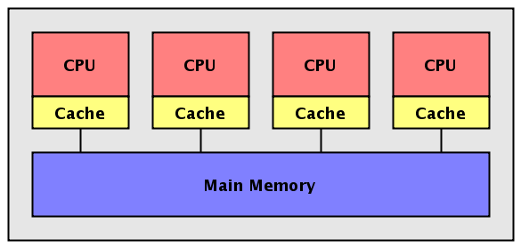
Shared Memory

Slide 5
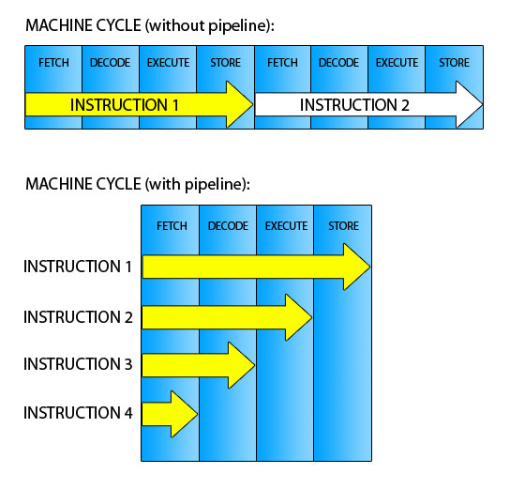
Pipelined CPU

Slide 6
Vector Processing
A vector is a set of scalar data items, all of the same type, stored in memory.
A vector processor is an ensemble of hardware resources, including vector registers, functional pipelines, processing elements, and register counters, for performing vector operations.
Vector processing occurs when arithmetic or logical operations are applied to vectors.
Vector processing speedup 10..20 compared with scalar processing

Slide 7
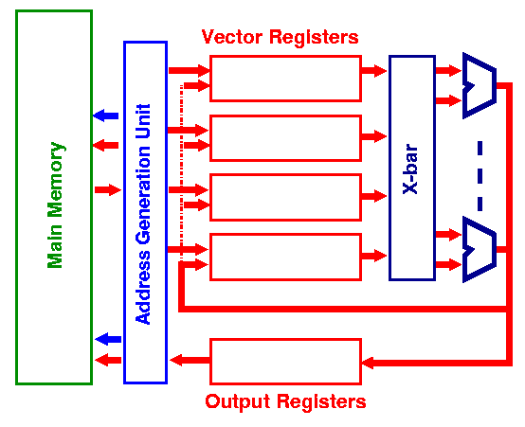
Vector Processor

Slide 8
SC Development
Processor numbers increased during 1980s
Shared memory became a problem so Distributed memory was used
Inter-processor communication became a key problem
Many interconnect network types were used

Slide 9
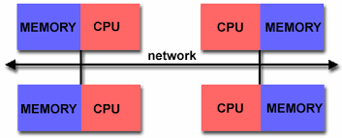
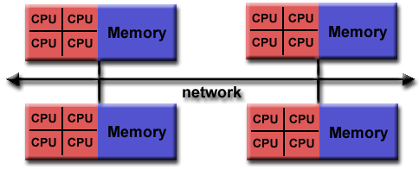
Distributed Memory

Slide 10
Current SC Architecture
Massively parallel
Thousands of processors
Fastest SC as per Top500 .org – Tianhe-2 (MilkyWay-2)
3,120,000 Cores
33,862.7 TFlop/s
1,024,000 GB RAM
Intel Xeon E5-2692v2 12C 2.2GHz processor
Kylin Linux OS
#2 on List is a CRAY XK7 (TITAN)
560,640 Cores
Opteron 6274 16c 2.2GHz processor
CRAY Linux OS

Slide 11

Tianhe-2

Slide 12


Slide 13
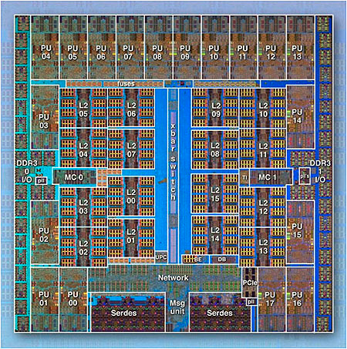
IBM BlueGene/Q Chip
18 Cores
16 L2 Cache

Slide 14
Super Computer OS
Early OS were custom written (modified) for each super computer
Some were proprietary
Since all batch jobs, scheduling is a non-issue
Programs written specifically for SC
No interactive jobs
No preemption
No time quantum

Slide 15
Early Job Scheduling
Job Management – Not Scheduling
Master Scheduler sends jobs to slaves
Slaves periodically report back
With few processors this was easy
Used peripheral processors for all I/O handling

Slide 16
Current Job Scheduling
Still Job Management – Not Scheduling
Most run a custom Linux version
Use multiple OS types in different nodes
Compute Node (CNKernel – 5,000 lines of code!)
No IO
No scheduling
No context switch
I/O Nodes (INK)
I/O node shared by multiple compute nodes

Slide 17
Current Job Scheduling
Some Job Managers use locality as a preference
Locality is based on the interconnect network
Most based on an extended hyper-cube called a Torus
Others use First Available processor

Slide 18
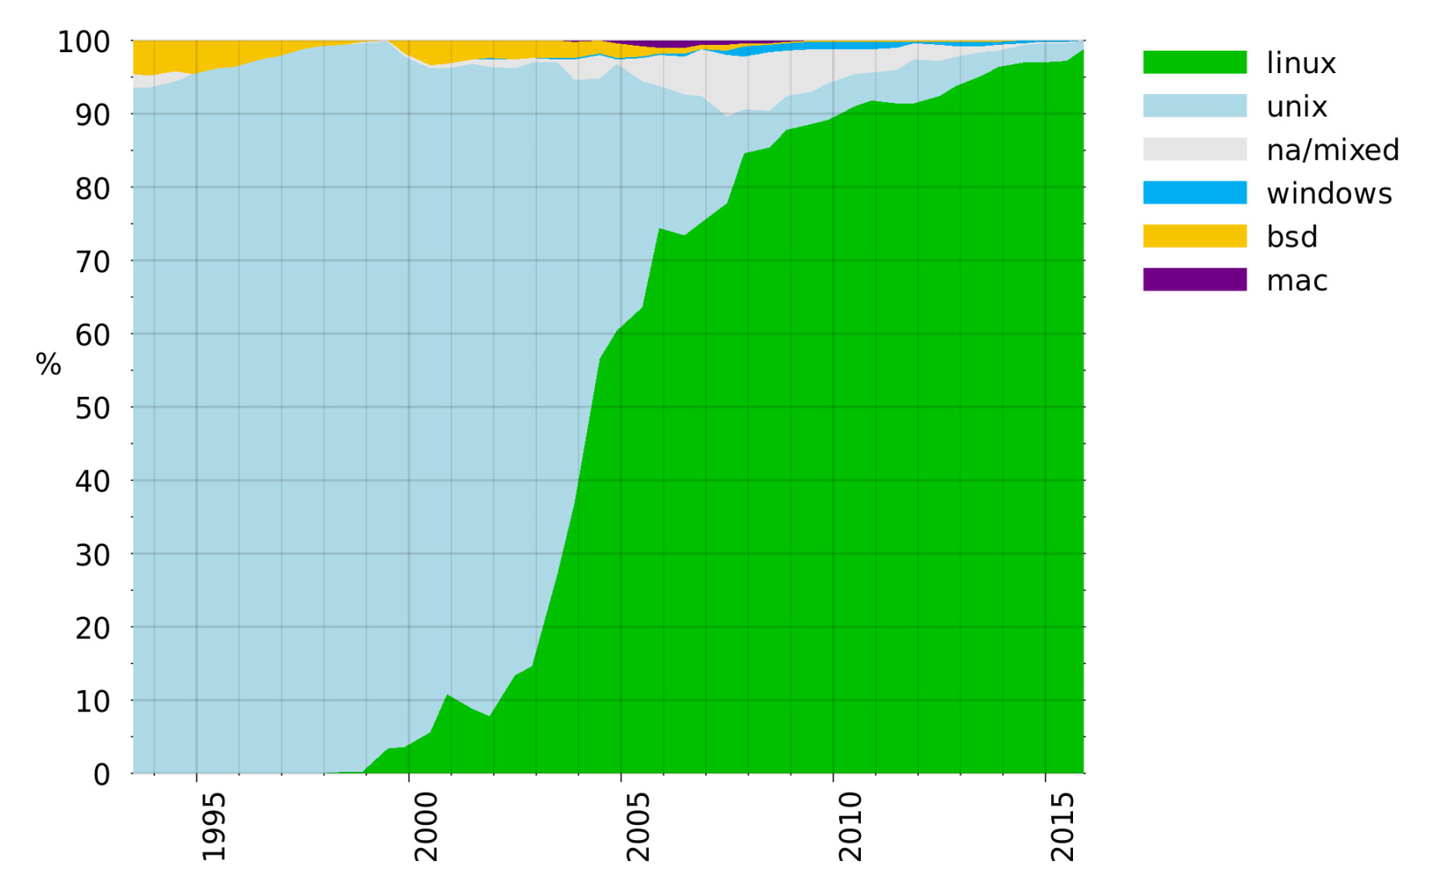
SC OS by Percentage

Slide 19
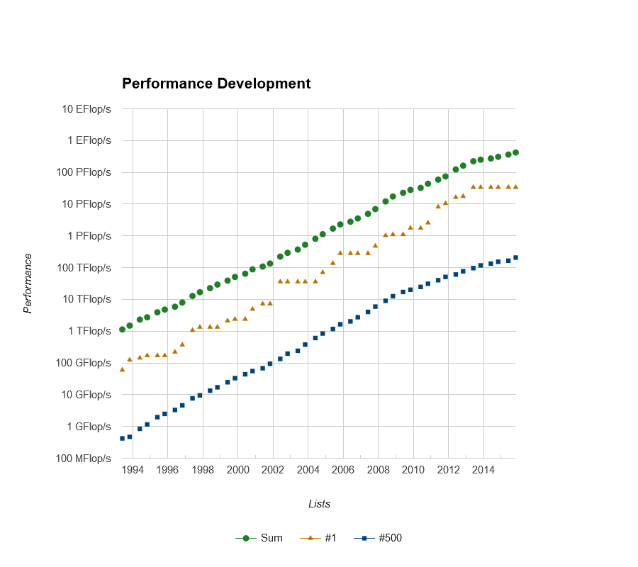

Slide 20
